Slide 1

Welcome to the Magical Potions Game
Your winnings in this game will earn you an additional payment bonus for participating in this study.
In any case you will still receive £6 per hour for completing this study.
However, you can earn up to an extra £1 based on your coin winnings in the game.

Slide 2
We will now provide instructions for the game. Please read them carefully.
You can go back and forth between screens as needed.

Slide 3
During the instructions, we will request that you complete a few brief quizzes
to ensure everything is clearly understood.

Slide 4
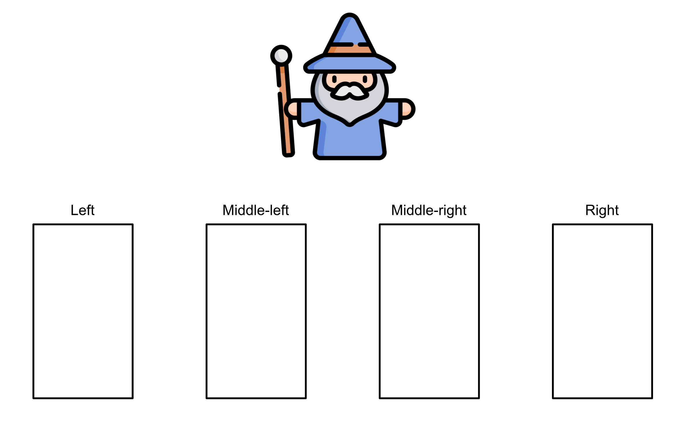
In our village, there is a wizard who has 4 magical potions, each shown as a black rectangle.

Slide 5
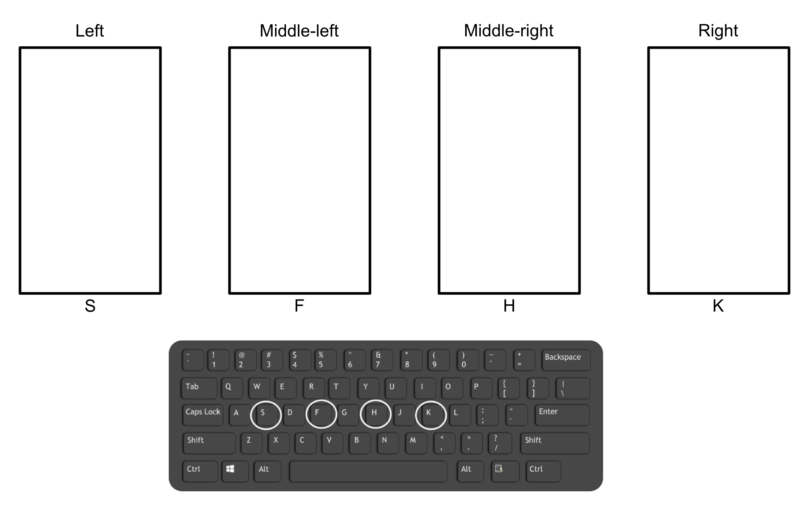
To make your selections in the game, you will press one of four response keys:
'S' for choosing the left potion,
'F' for choosing the middle-left potion,
'H' for choosing the middle-right potion,
'K' for choosing the potion on the right.

Slide 6
The wizard needs colored leaves for his four potions and will pay you golden coins to get them!

Slide 7

There are 2 types of leaves in the forest.
Young leaves, which are green and the wizard can never use for his potions.

Slide 8
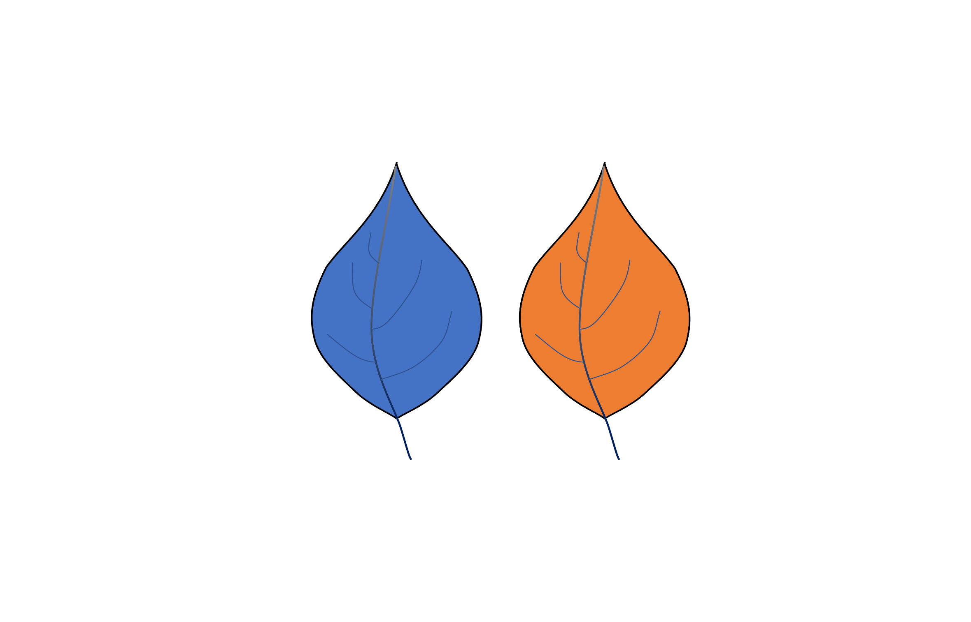
And fully grown, potion-ready leaves, which are not green.
At all times, the wizard needs the two non-green leaves equally,
since they always have the same effect on his magic.

Slide 9
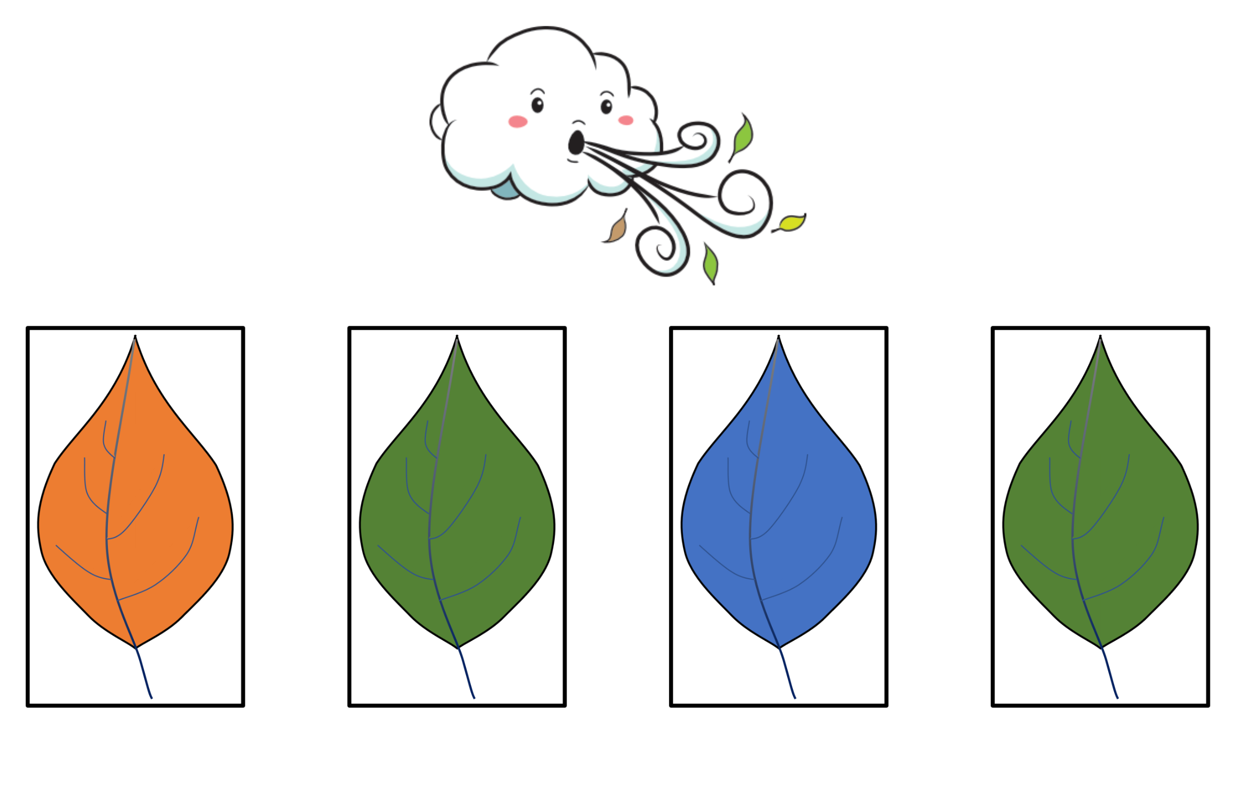
At each step in the game, the forest wind will cause four leaves to randomly fall from a magical tree onto the four potions,
just like in the picture below.

Slide 10
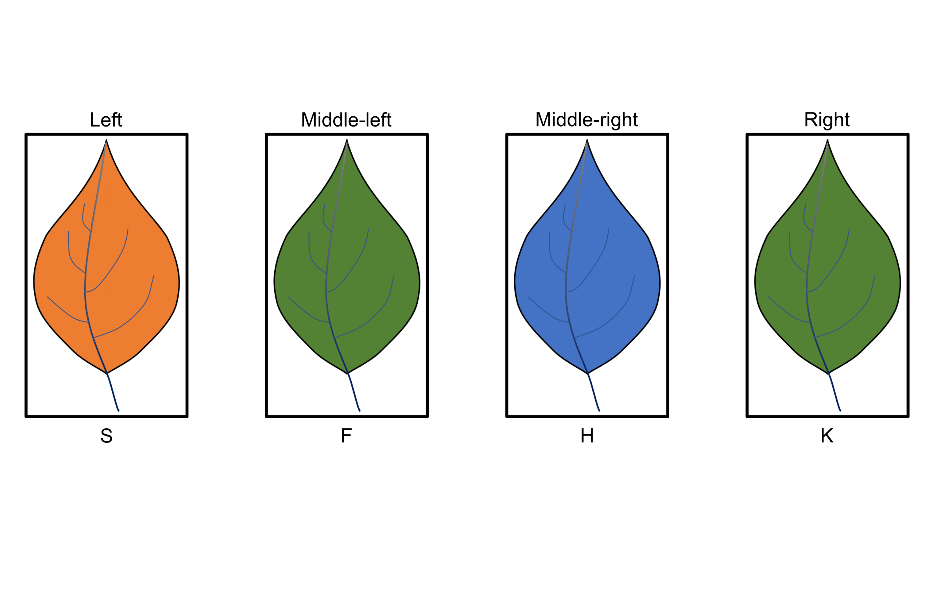
Each time, there will be two potions that contain a non-green leaf.
You can only choose these two potions.
You cannot choose potions that contain green leaves.
For example, if you want to choose the potion on the left, you press 'S'.
If you want to choose the potion located in the middle-right, you press 'H'.

Slide 11
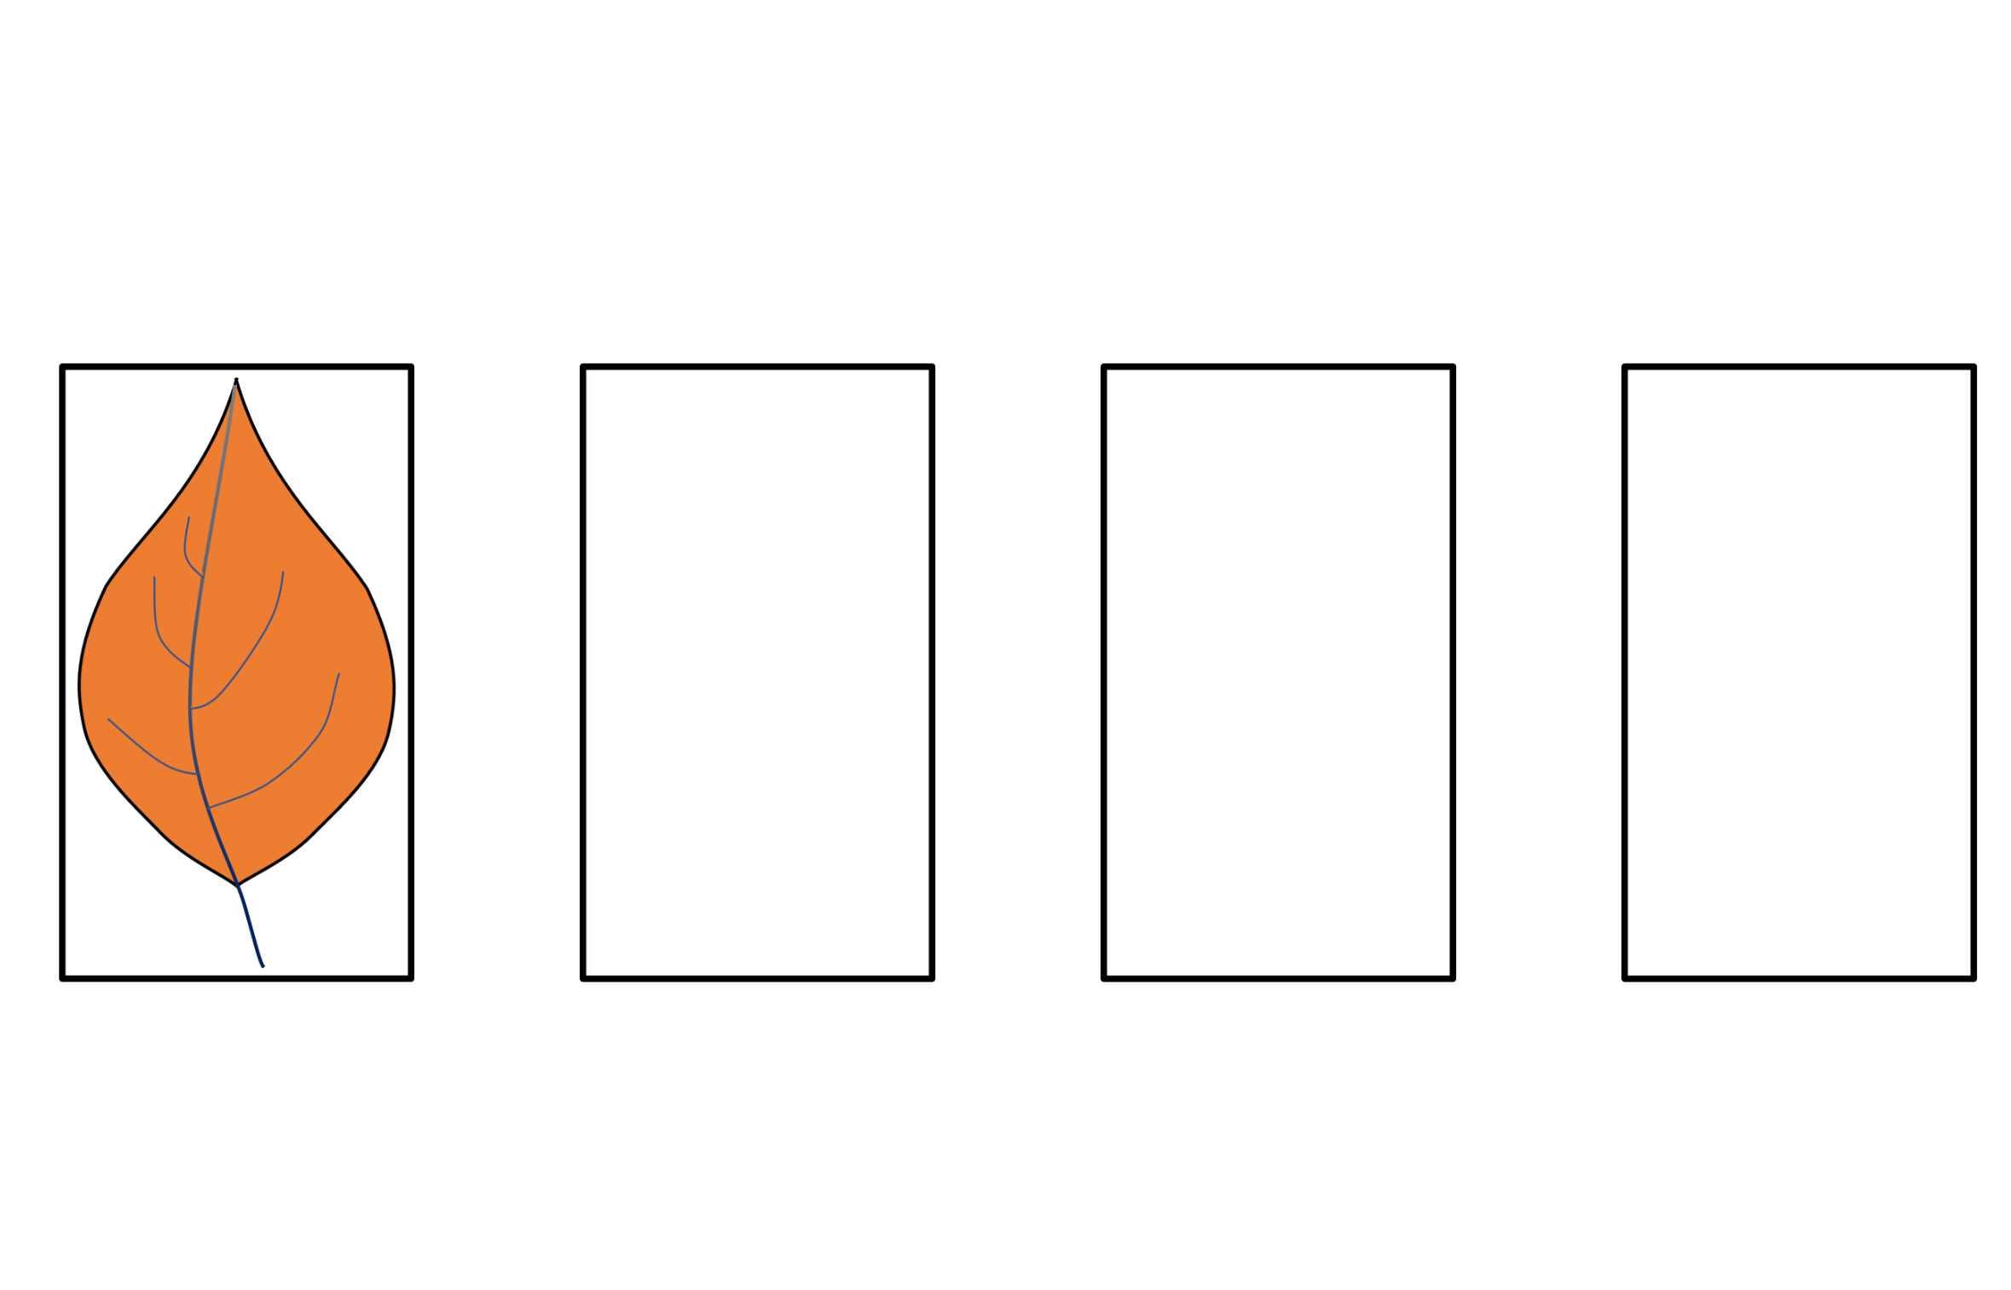
Once you have made your selection, you will see the chosen potion.

Slide 12
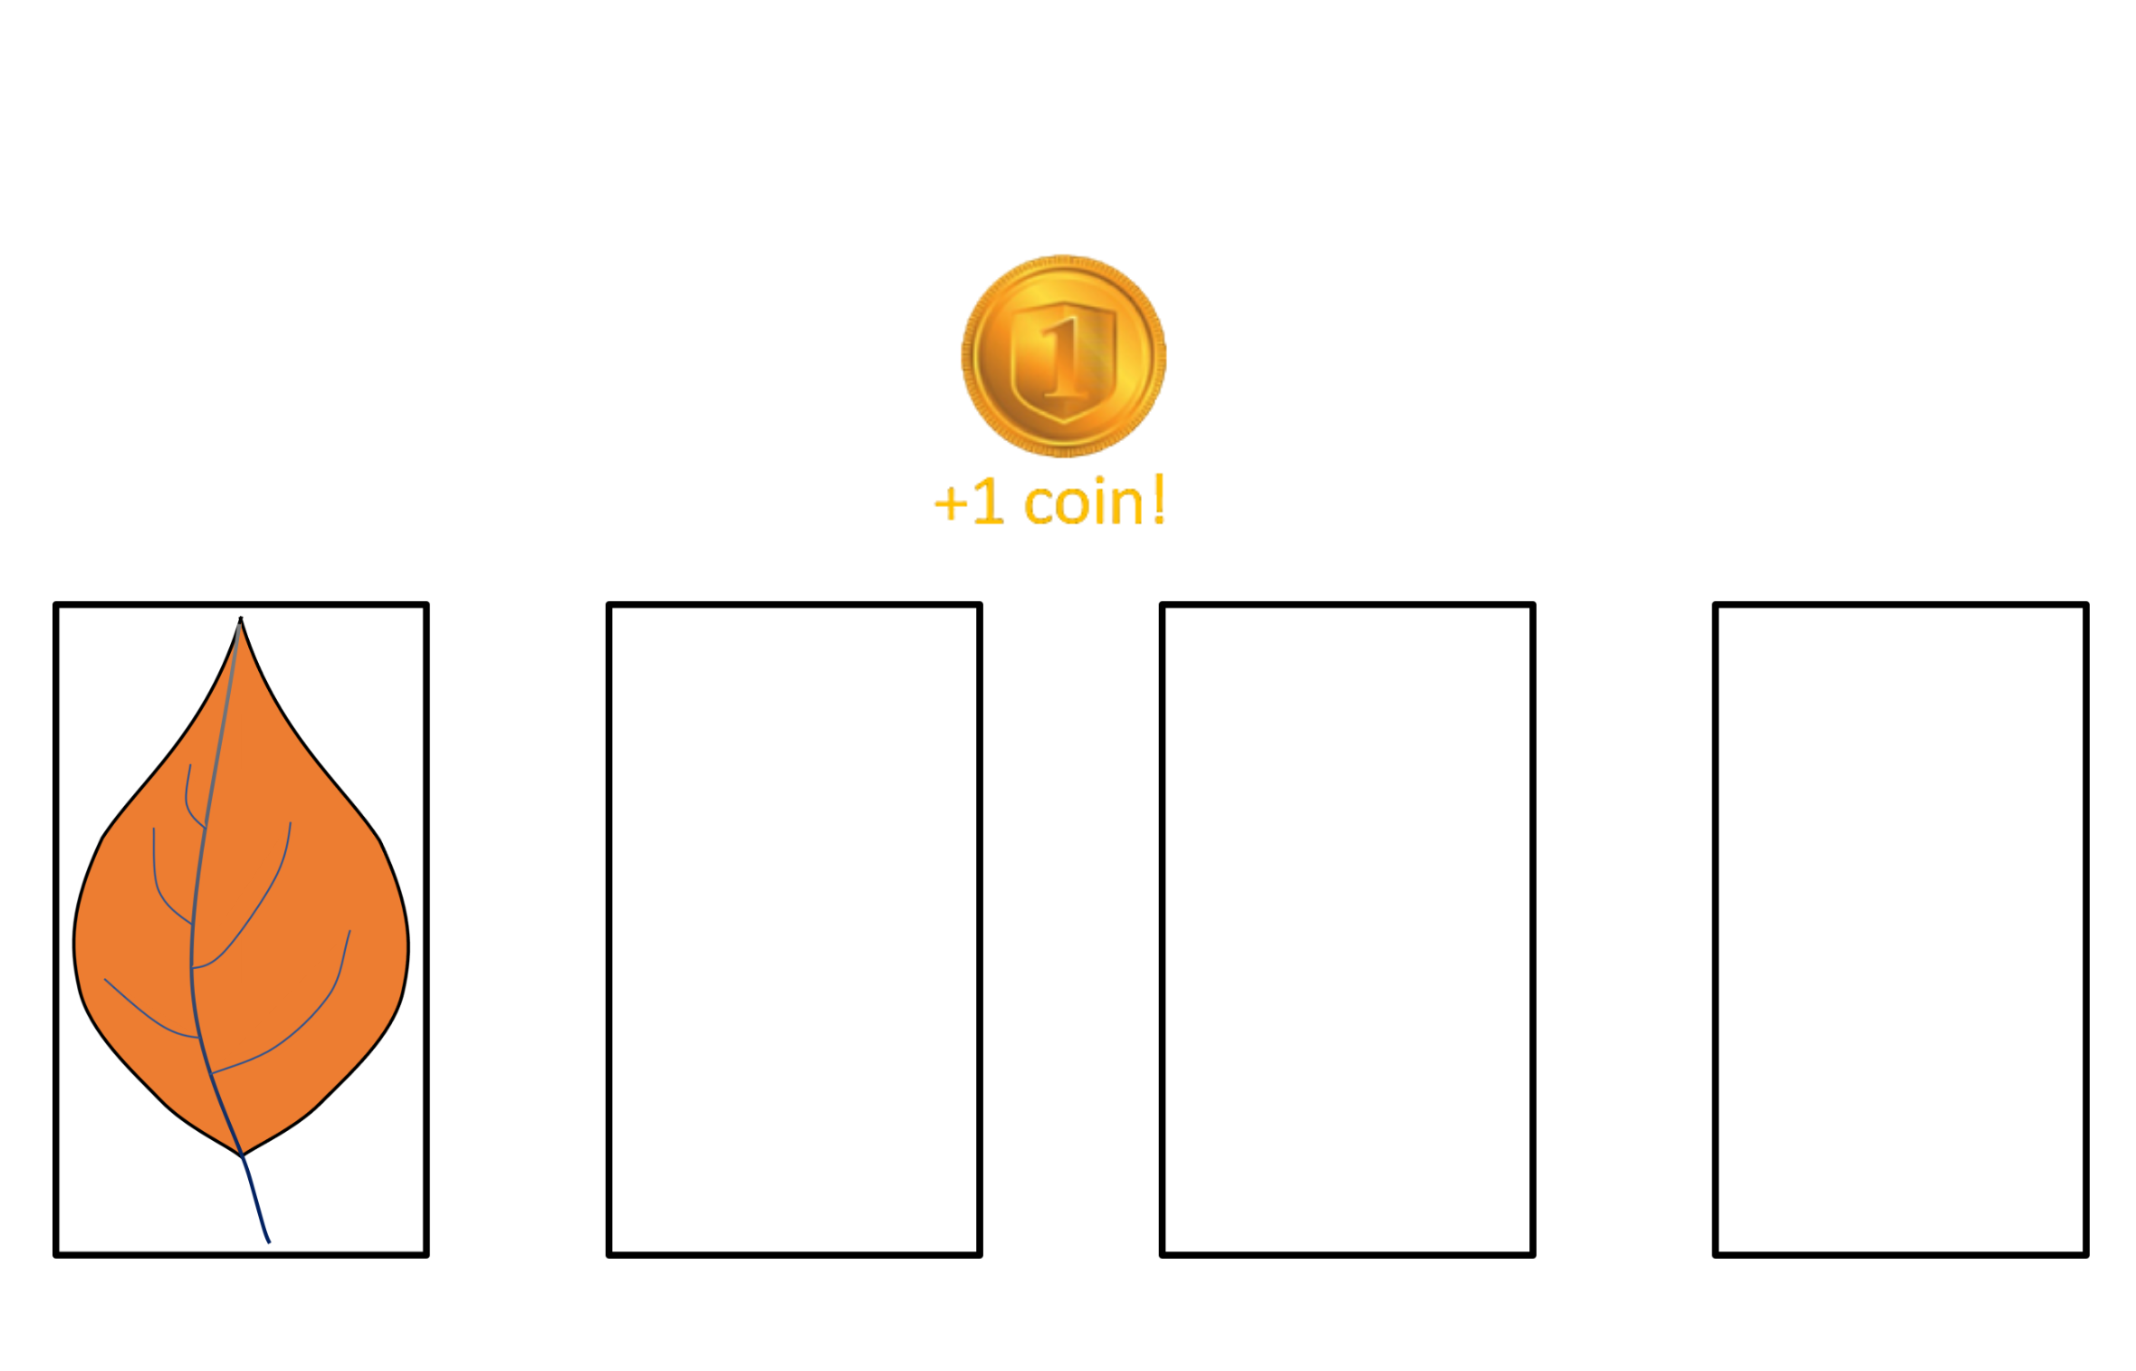
Then you will see whether the wizard decided to buy the leaf for this potion or not.
If the wizard buys it, you will earn one golden coin.
The coin will appear in the middle of the screen.

Slide 13
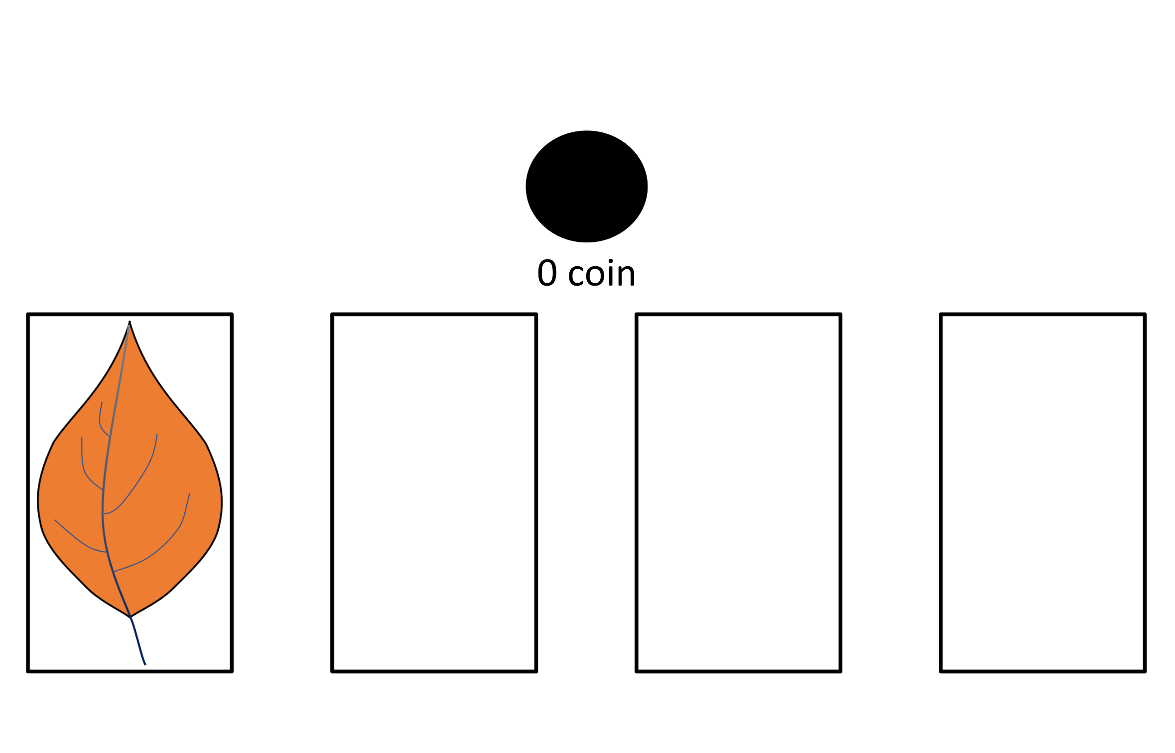
If the wizard chooses not to buy it, you will earn nothing,
and a black coin will be displayed.

Slide 14
You will play 4 rounds of 50 choices.
After each round, you can take a short break, and the game will continue right where you left off.
The golden coins you earn will be exchanged for a bonus payment at the end of the experiment – so your decisions matter!

Slide 15
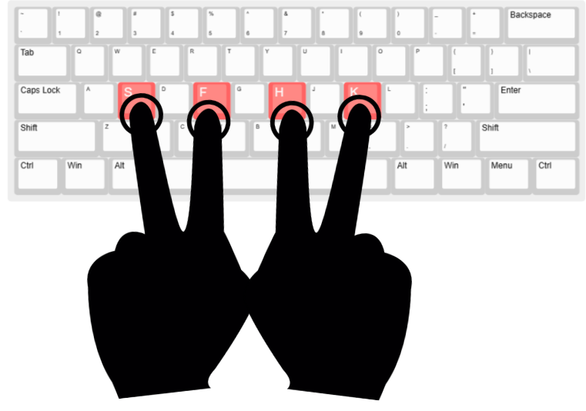
We will now do a few practice trials.
Please be ready with your left-hand fingers on "S" and "F",
and your right-hand fingers on "H" and "K".
Press any key to begin

Slide 16
You will now take a brief quiz to make sure that you understand the instructions.
If you make a mistake, you will need to review the instructions again.
Press any key to continue

Slide 17
Quiz – Understanding the Instructions
Q1. How many potions in total are there in the game?
○ 2 ○ 4 ✓ ○ 6
Q2. How many potions are available for choice each time?
○ 2 ✓ ○ 4 ○ 6
Q3. How do you choose the left potion?
○ S ✓ ○ F ○ H ○ K
Q4. How do you choose the middle-right potion?
○ S ○ F ○ H ✓ ○ K
Q5. What is the goal of the game?
○ The goal is to try and make the best selections and earn as much bonus money as I can ✓
○ The goal is to pick green leaves

Slide 18
To help you succeed in the game as much as possible we will now provide some important clarifications.
Read them carefully, as we will quiz you about these clarifications to confirm your understanding.

Slide 19
1) The chance of winning a coin depends on the potion you choose.
At any given time, each potion (left, middle-left, middle-right, right) has a certain value for the wizard.
As you already know, the wizard doesn't always buy the leaves.
If you choose a potion that the wizard currently values highly, you have a higher chance of selling to him.
In contrast, if you choose a potion that the wizard currently assigns little value to, you have a lower chance of selling to him.
Therefore, you need to track the outcomes across time and do your best to learn the wizard's value to each potion.
Your job is to make a potion selection that will lead to the highest chance of gaining rewards, and obtain the highest amount of gold coins.

Slide 20
2) The value of the potions slowly changes.
Note that throughout the game, the value of each potion slowly changes.
Similar to how the demands of market products change.
So for example, if a certain potion is highly valuable to the wizard at the start of the game,
its value might still decrease/increase over time.
You need to keep sharp, track the outcomes you see when selecting the potions,
and try your best to make selections that will maximize the number of golden coins earned.

Slide 21
3) Each potion has its own value.
Now that you know that each potion has a certain value for the wizard,
it's important to keep in mind that each potion has its own demand.
Learning about one potion tells you nothing about the other potions.
For example, two, three, or even all four potions may be highly valued by the wizard at a certain time.
The outcome you see after selecting a potion is related only to the value
of that specific potion and means nothing regarding the value of the others.
Your task is to figure out the wizard's preferred potions at any given time and select them.

Slide 22

4) The blowing wind is completely random.
As you already know, after the four colored leaves fall from the magical tree,
the wind blows them to the different potions.
You can only choose potions containing a non-green, potion-ready leaf.
The exact color of the non-green potion-ready leaf has no meaning to the wizard.
Choose only based on the potions.

Slide 23
You will now take a brief quiz to make sure that you understand the instructions.
If you make a mistake, you will need to review the instructions again.
Please scroll down until you answer all the questions.
Press any key to continue

Slide 24
Quiz – Understanding the Clarifications
Q1. The demand for a potion can change during the game
○ True ✓ ○ False
Q2. If one potion leads you to win more coins, it means the other potions will probably lead you to win less coins
○ True ○ False ✓
Q3. The wizard cares about the exact color of the non-green potion-ready leaf
○ True – the specific color of the non-green grown leaves is related to the coin winning chances
○ False – you won't win more or less depending on the color of the grown leaf.
Only the potions are related to your coin winning chances. ✓
Q4. What determines which leaves get to which potion?
○ The wind ✓ ○ The wizard ○ The leaves themselves ○ The demand for the potions

Slide 25
Just before starting the game, let's test once again the clarity of our instructions using an illustrative example.

Slide 26
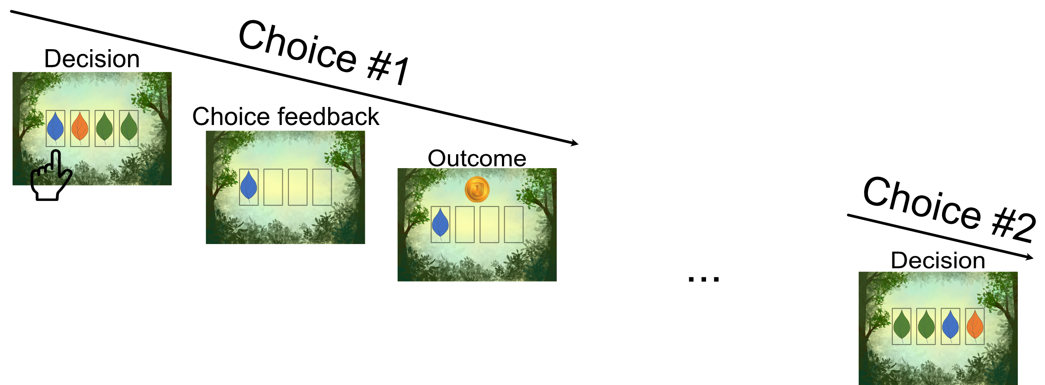
Q1) Here is an example for a participant that chose in choice #1 the left potion, and got a reward.
What should be the preferred next choice when two new potions are possible for selection?
○ I prefer the middle-right potion in choice #2
○ I prefer the right potion in choice #2
○ I have no information about the two potions offered in choice #2 so I have to guess ✓

Slide 27
Correct! Good job!
If you haven't selected these potions before, please pick one at random.
The specific grown leaf color does not affect your odds of winning a coin.
Let's do one more final question.

Slide 28

Q2) Here is an example for a participant that chose in choice #1 the left potion, and got a reward.
In the next trial the choice was between a potion that was offered in the previous choice, and a new potion.
What should be the preferred next choice?
○ I prefer the middle-left potion in choice #2
○ I prefer the right potion in choice #2
○ I have no information about the two potions offered in choice #2 so I have to guess ✓

Slide 29
Correct! Good job!
If you haven't selected these potions before, please pick one at random.
What you learn about a certain potion has nothing to do with the demand for the other potions.

